Slide 1

History of Virtualization
Virtual Machines Vs Containers
By Srikrishna.

Slide 2

Disclaimer
Its just my learning and knowledge. I am no
subject mater export nor worked on any of this

Slide 3
Let me understand you better to
make it simple…
01
02
Have you ever installed
Operating System?
Have you ever used
Virtual Machines?
03
04
Have you ever used any
Cloud services ?
Have you ever used
Containers?

Slide 4
Virtualization is there for decades,
why everyone wants Docker now?
What is the motivation of
this talk?
Why Hypervisor based Virtualization
is heavy weight?
Why Docker based Virtualization is
light weight?

Slide 5
What is Operating System?
How Operating System works?
For that we need to
Understand this first.
What is Virtualization?
Hypervisor Virtualization
Container Virtualization

Slide 6
Then let’s just start with what is
Operating System?

Slide 7
User Space
Operating
System
Kernel Space
Hardware Space

Slide 8





All used installed applications
Gallery/Player/Editor
SHELL
GUI
IPC
Network Services
I/O Management
Process Management
Memory Management
Virtual/File System
Device Drivers

Slide 9
Fair enough. lets understand how these
things works together.

Slide 10
OS Starting Sequence
1
3
5
BIOS
Kernel
User Apps
2
4
Bootloader
OS Apps

Slide 11
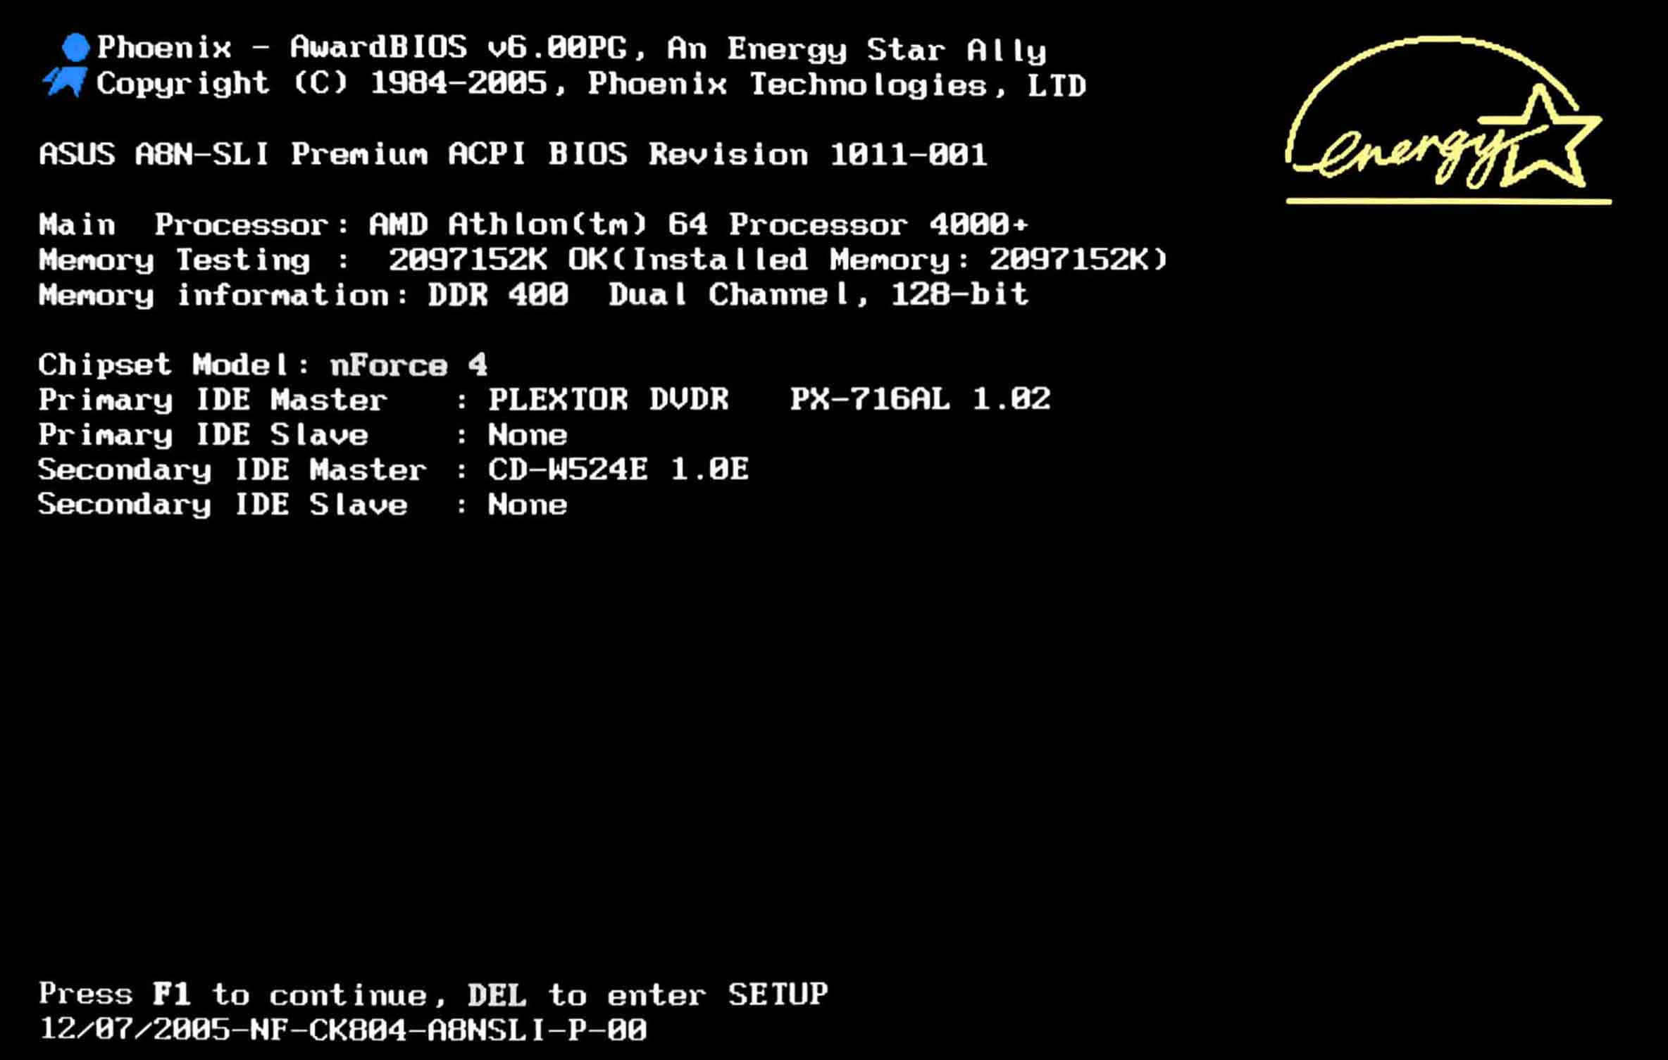

Slide 12
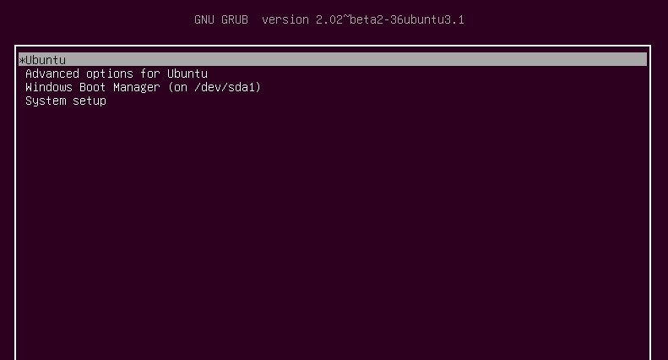

Slide 13
Example systemd log
https://upload.wikimedia.org/wikipedia/commons/a/ab/Systemd-on-fedora.png

Slide 14
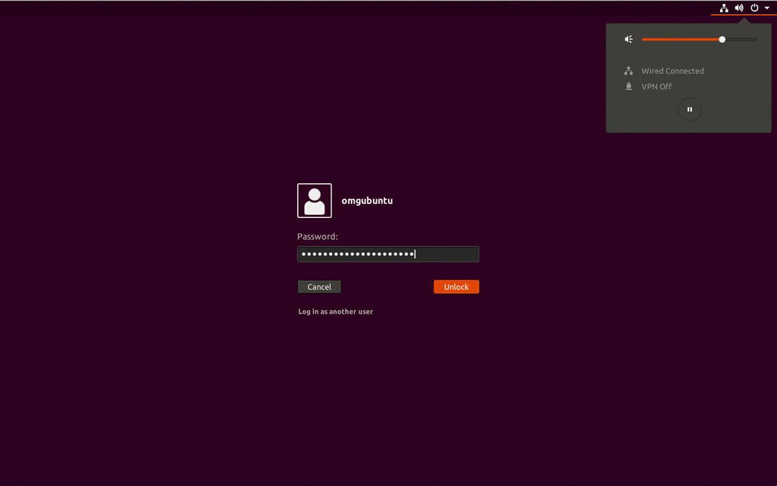

Slide 15
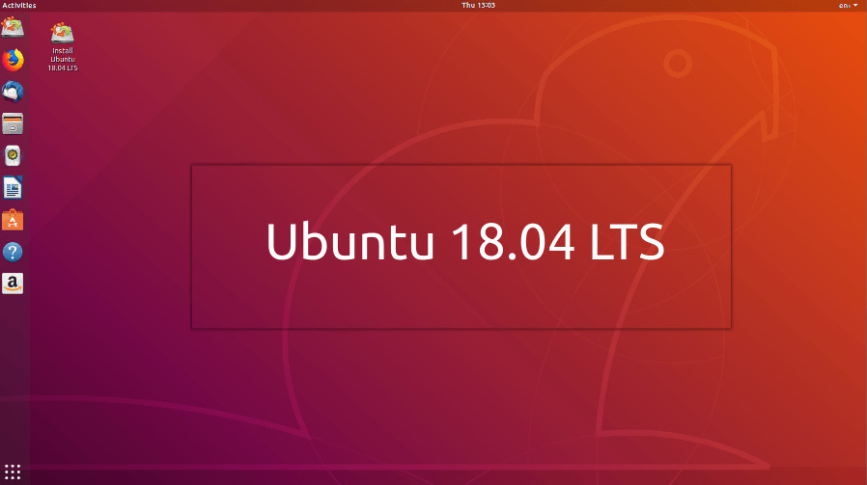

Slide 16
Let’s take a deep look into systemd process tree

Slide 17
That’s how operating system works.
Simple, is not it ?

Slide 18
People went crazy, and wanted to install
OS on top of OS

Slide 19
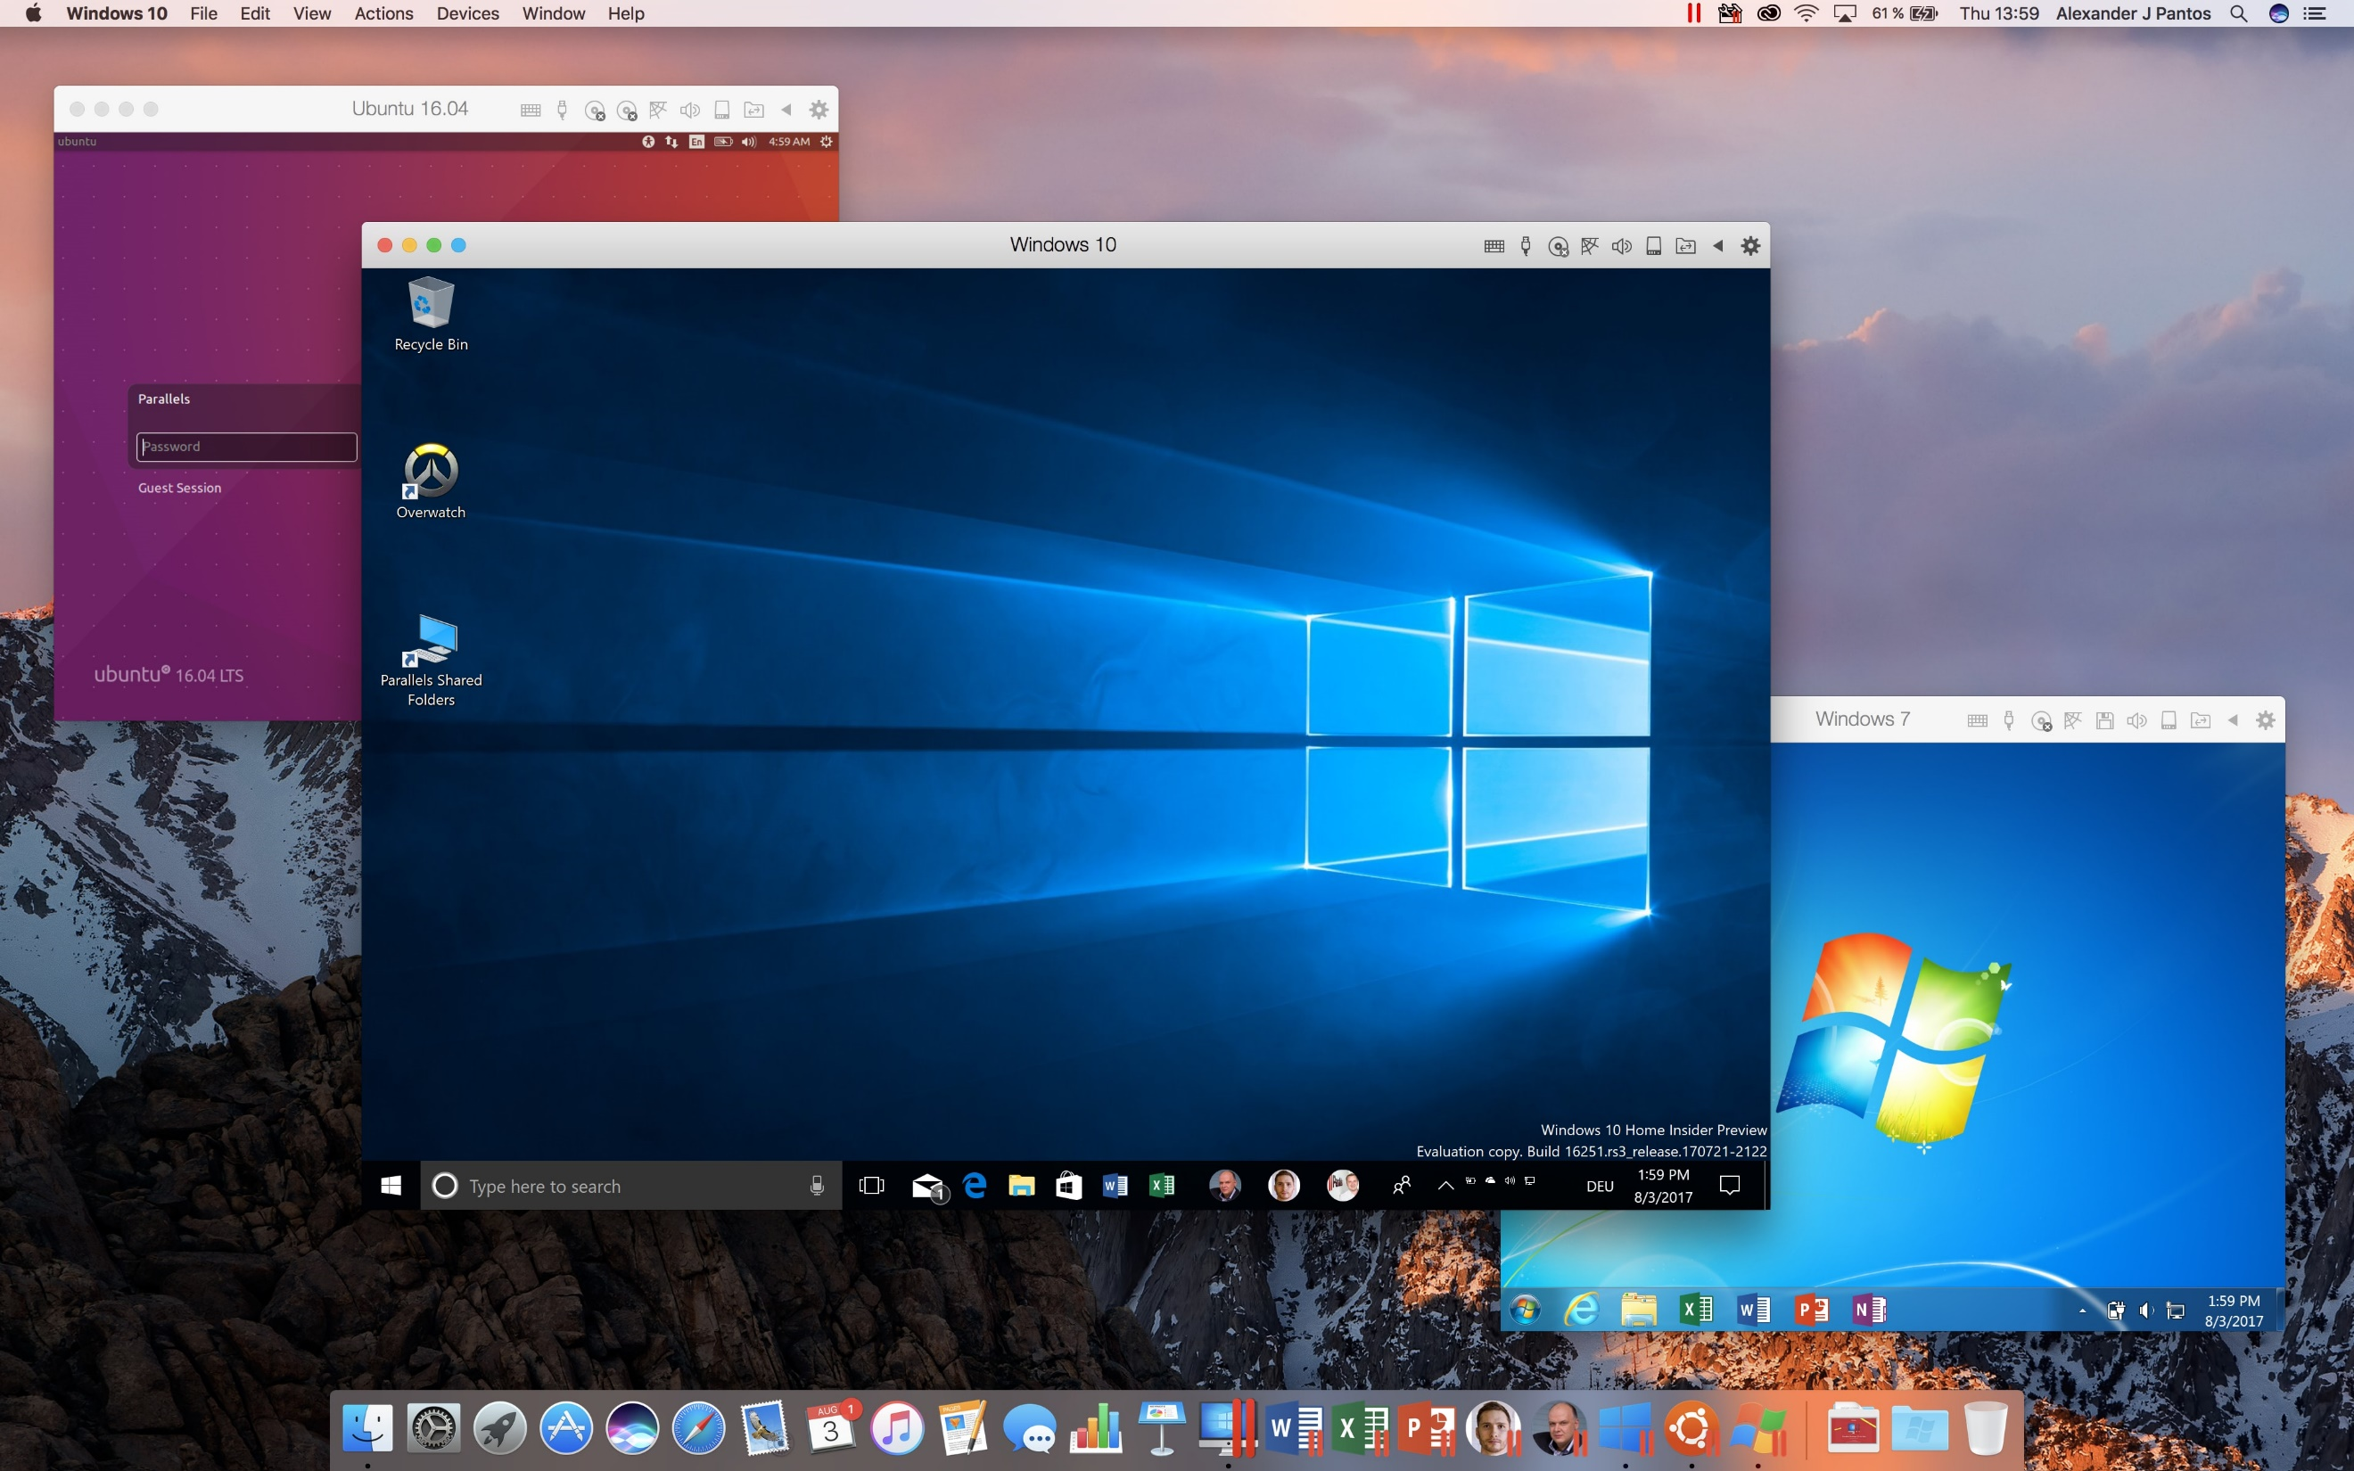

Slide 20
This is called Virtual Machine.
Precisely hardware or software virtualization

Slide 21
Hypervisors are born to full fill Crazy idea.

Slide 22
Hypervisor based Virtualization
VM
VM
App A/Libs
App B/Libs
App A
App B
Guest OS
Guest OS
Bins/Libs
Bins/Libs
Hypervisor T2
Guest OS
Guest OS
Host OS
Hypervisor T1
Infrastructure
Infrastructure

Slide 23
Applications are portable
Applications run any ware
Large scale app management
Anyway why would
anybody wants virtualization?
Effective use of hardware
Application Isolation & limits
App requirements are different
What ever Docker enjoys …

Slide 24
But still hypervisors are expensive in both cost and operations

Slide 25
Only handful of company's can able to manage or offer it

Slide 26
More over virtualization is not a crazy idea nor ops problem, it’s a revolution.

Slide 27
Yes.! Cloud is the result of that revolution

Slide 28
Demo time for a simple cloud vultr.com

Slide 29
Since cloud today hypervisors are more powerful

Slide 30
Type 1 Hypervisors
Type 2 Hypervisors
Xen
VirtualBox
Amazon Web Services
Oracle Product
KVM
Virtual PC
AWS, GCP, DO, Vulter
Microsoft Product
Hyper-V
VM Workstation/Server
Azure
VMWare Product
EXSi
VM Fusion/Player
Google Cloud Platform
VMWare Product

Slide 31
Apache CloudStack
Hypervisor Orchestrators
OpenStack
Opennebula

Slide 32
Even though Hypervisor
are better, still not
for every one.
Still not able to full fill original ideas with ease

Slide 33
So people are working on something light weight and easy to use
This work is also started before cloud revolution

Slide 34
Just application level
virtualization, With out need
of another OS
And they defined light weight virtualization as?

Slide 35
cgroups was built by google and donated to Linux

Slide 36
Namespaces are developed by IBM for its Unix. Later the idea was adapted to Linux

Slide 37
With these two features combined Linux containers are born. LXC & LXD

Slide 38
It is light weight as promised but still hard to play with

Slide 39
Still only handful of Organization able have kernel engineers

Slide 40
Docker simplified the containers for everyone and made dev and ops guys friends.

Slide 41
Imagine writing a web app in C lang (LXC) Vs Spring boot (Docker)

Slide 42
Docker based Virtualization
VM
VM
CONTAINER
App A/Libs
App B/Libs
App A
App B
App A
App B
Guest OS
Guest OS
Bins/Libs
Bins/Libs
Bins/Libs
Bins/Libs
Hypervisor T2
Guest OS
Guest OS
Docker
Host OS
Hypervisor T1
Host OS
Infrastructure
Infrastructure
Infrastructure

Slide 43
Lets see the containers virtualization in action.
Deep dive inside containers

Slide 44
Containers & Ace of use is the
Game changer

Slide 45
Now you know little secret behind the Docker

Slide 46
Thank You For Lıstenıng
We love to hear you
Feel free to say hi! If you have anything to ask
srikrishna.s@sella.it

